Slide 1
SENTIMENTAL ANALYSIS USING IMDb Movie REVIEWS
Done by : 180330004 - A.Lohit
180330003 - K.Jayathi
180330026 - K.Vaishnavi
180330027 - K.Sri Charitha

Slide 2
LITERATURE SURVEY
AUTHORS
1.Byran Tan
2.Ankit Goyal and Amey Parulekar
3.Lakshmi pathi N
4.Angcar Li
5.Mohammad Wasil
https://www.kaggle.com/lakshmi25npathi/sentiment-analysis-of-imdb-movie-reviews
https://cseweb.ucsd.edu/classes/wi15/cse255-a/reports/fa15/003.pdf
https://towardsdatascience.com/imdb-reviews-or-8143fe57c825
https://www.andrew.cmu.edu/user/angli2/li2019sentiment.pdf
https://github.com/MohammadWasil/Sentiment-Analysis-IMDb-Movie-Review

Slide 3
The IMDB data set reviews are entrenched by gathering data from Kaggle.
We evaluated the model using confusion matrix
We used word cloud to plot the negative and positive words from the reviews.
We tried different algorithms to predict the accuracy and Using LTSM model we predicted the review is positive(1) or Negative (0).

Slide 4
REFERENCES
Sentiment Analysis – Wikipedia – https://en.wikipedia.org/wiki/Sentiment_analysis
Natural Language Processing from Scratch - http://static.googleusercontent.com/media/research.google.com/en//pubs/archive/35671.pdf
Pang, Bo; Lee, Lillian; Vaithyanathan, Shivakumar (2002). "Thumbs up? Sentiment Classification using Machine Learning Techniques". Proceedings of the Conference on Empirical Methods in Natural Language Processing (EMNLP).
NLTK Stopwords Corpus: http://www.nltk.org/book/ch02.html

Slide 5
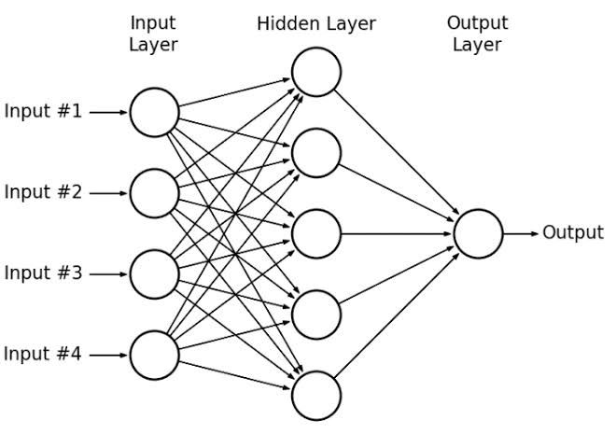
ARCHITECTURE

Slide 6
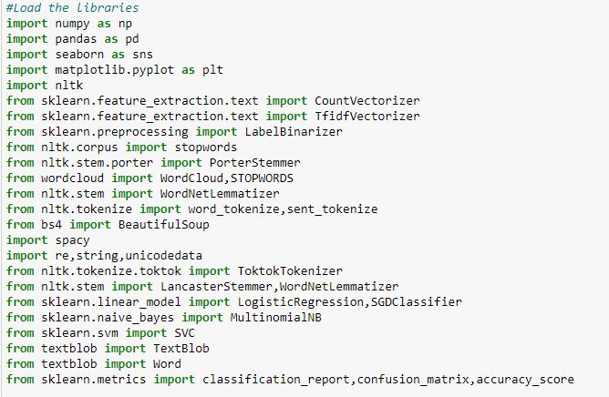
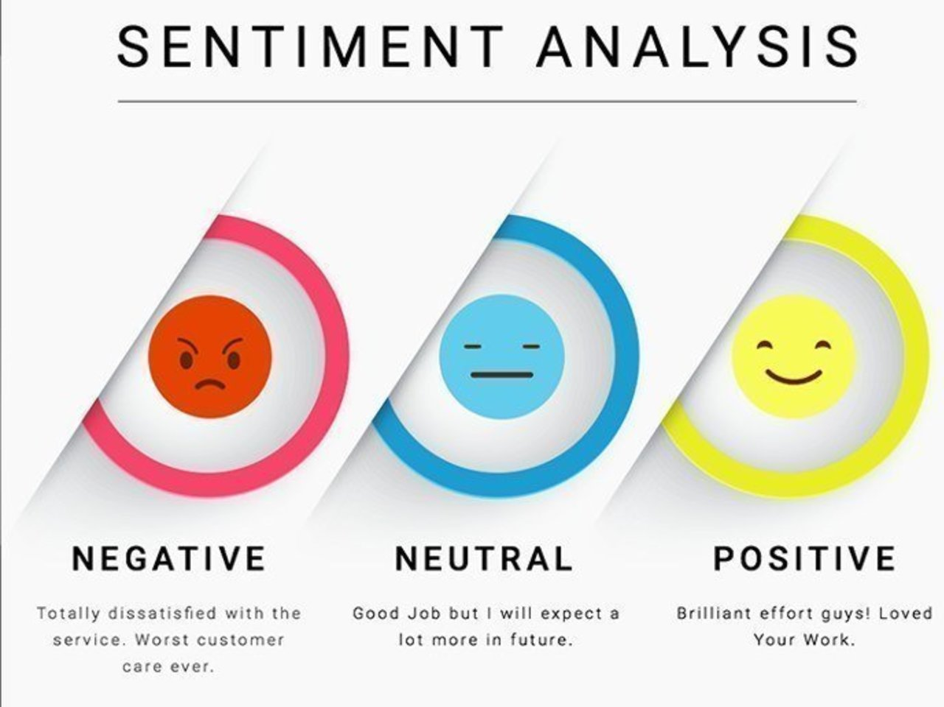
IMPLEMENTATION

Slide 7
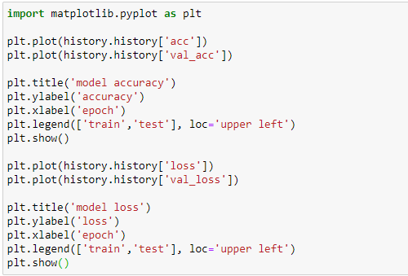

Slide 8
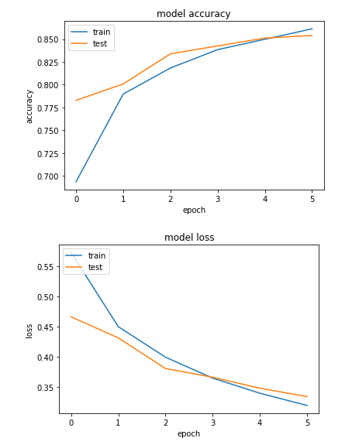

Slide 9
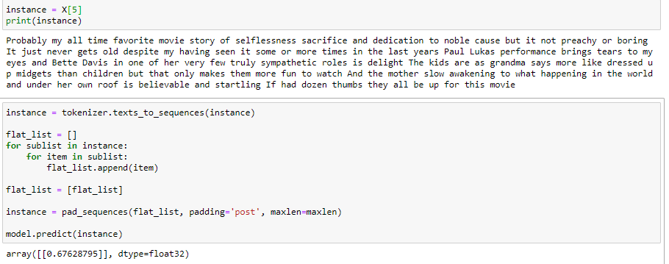

Slide 10
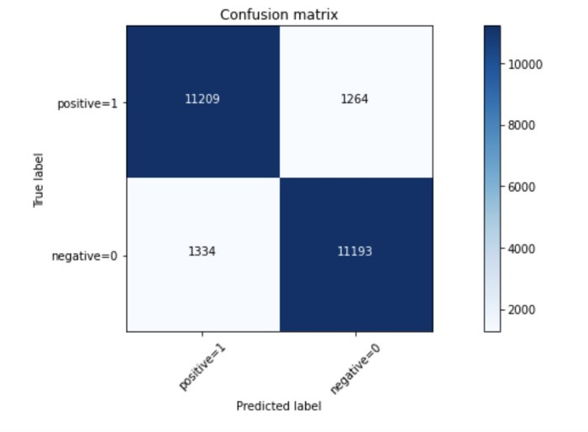
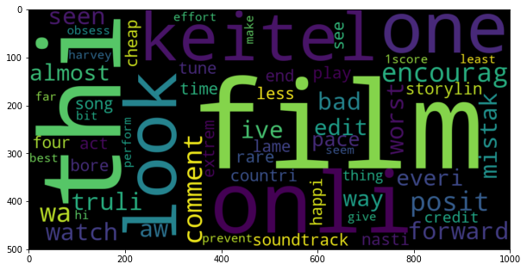
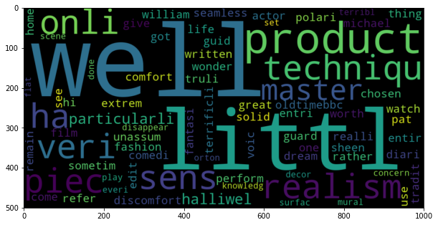
We have obtained a confusion matrix based on the reviews i.e positive or negative
We even used wordcloud to plot the positive and negative words from the dataset

Slide 11
NOVELTY OF THE WORK
In the last review we have used one dimensional CNN, Simple Multi-Layer Perceptron and shown the Accracy which was not upto the requirement
Now we have tried different Types of Algorithms like
Naive Bayes
Logistic Regression
Ensemble
Support Vector Machine
Random Forest

Slide 12
Comparison of different ML algorithms:
So by using these different machine learning algorithms we have got the accuracy as shown below
So here we can clearly observe that Logistic regression and SVM gave the best accuracy compared to the others algorithms.
Algorithm | Accuracy
Logistic Regression | 86.9
Naïve baiyes | 82.1
Random forest | 80.8
Support Vector Machine | 87.0
Ensemble | 84.9

Slide 13
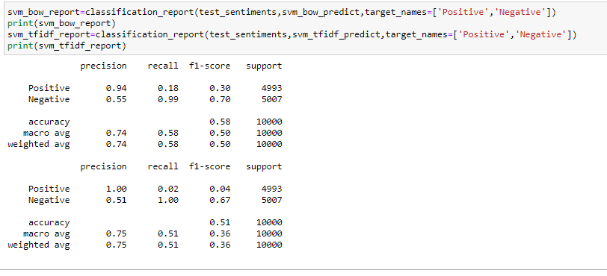

Slide 14
ANALYSIS
We have framed this analysis as natural language accessing problem. The input layer consists of over 25,000 reviews
The output layer consists of the epoch values for every single data and gives the accuracy.
We have used different algorithms to find the best accuracy among them.

Slide 15
We have trained the data, displayed the records and classified the reviews as Negative(0) or Positive(1).
By using this data we can only predict whether the review is Positive or negative and predict the accuracy.
Finally we plotted negative and positive words using wordcloud.

Slide 16

Future Enhacements
One of the major improvements that can be incorporated as we move ahead in this project is to merge words with similar meanings before training the classifiers
Another point of improvement can be to model this problem as a multi-class classification problem where we classify the sentiments of reviewer in more than binary fashion like “Happy”, “Bored”, “Afraid”, etc
This problem can be further remodeled as a regression problem where we can predict the degree of affinity for the movie instead of complete like/dislike.

